Slide 1

Implementation of bitcoin model using Blockchain
TEAM – PERFECT DEALERS
BL.EN.U4AIE19028 - K.VISHNU SAINADH
BL.EN.U4AIE19034 - K.SATWIK
BL.EN.U4AIE19066 - V.ASHRITH

Slide 2

What is Block-Chain technology ?
It is a system for recording information i.e., a specific type of database
The information in block chain is very difficult to hack or tamper
It is a digital ledger of transactions
It is duplicated and distributed across the entire network
The database here is managed by Distributed Ledger Technology (DLT)

Slide 3
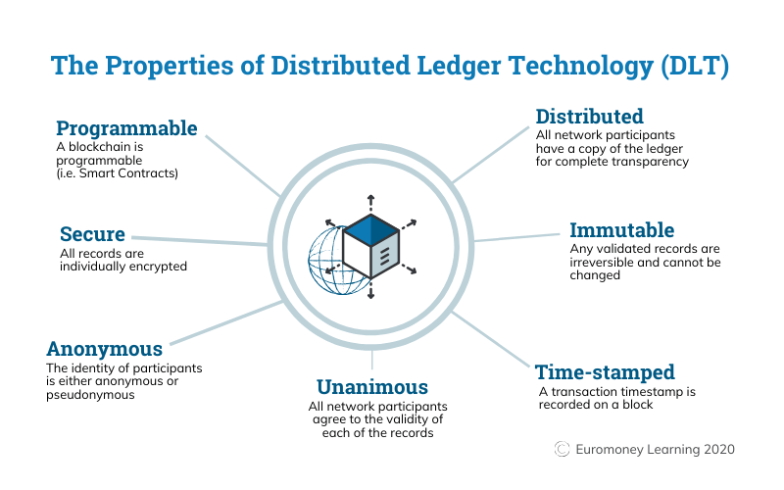

Slide 4

Role of blockchain in bitcoin technology
There have been many attempts to create digital money in the past, but they have always failed
The main issue was trust
Bitcoin was designed to solve this problem by using a database called blockchain
In SQL database, we need to have someone in charge who can change the entries (which is not safe)
So, we use blockchain as it is different because nobody is in charge
it’s run by the people who use it which makes it difficult to be hacked or tampered

Slide 5
What are Merkle trees ?
Merkle Tree is a way of structuring data that allows a large body of information to be verified both efficiently and accurately
Merkle Tree is used by blockchain to save on memory and processing power while keeping everything secure
Merkle Tree is a process for verifying data that would allow computers to work much faster than before
Merkle trees basically work on hashing
Hashing functions are mathematical algorithms that take inputs and generate unique outputs
SHA-256 is a hashing function which is used by bitcoins

Slide 6
Working...
Each transaction in a block on a blockchain has its own unique transaction ID
Merkle Trees take these IDs and run them through a hashing function that results in one 64-character code
This is merkle root, but if we consider one block in a blockchain it has only one merkle root.
Let's see how:
Merkle Trees always group all the data inputs into pairs.
If there happens to be an odd number of inputs, then the last input is copied and paired with itself.
This applies to all transaction IDs written onto a block in a blockchain

Slide 7
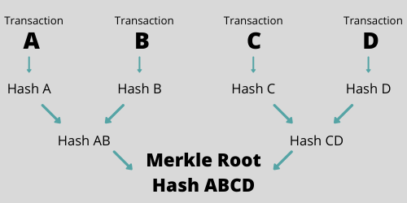

Slide 8
Data Verification
We download some chunk of data from the untrusted network.
We ask the server to provide the proof that this chunk is in the tree.
The server returns the appropriate hashes.
Using this information, you compute the root hash and verify it against the root hash with which you accessed the file.

Slide 9
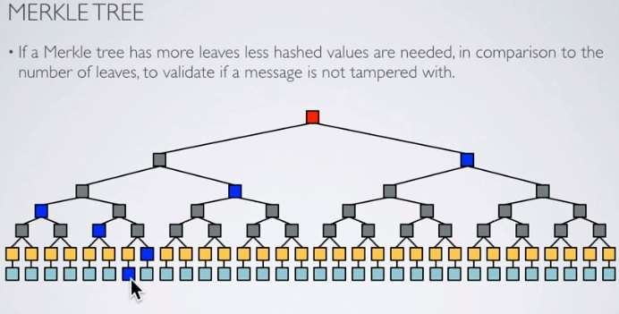

Slide 10
The Benefit of Merkle Trees
They provide a way to prove both the integrity and validity of data
They significantly reduce the amount of memory needed to do the above
The required management only needs small amounts of information to be transmitted across networks
Simplified Payment Verification (SPV) – a way of verifying transactions in a block without downloading an entire block. Often used by lightweight Bitcoin clients.

Slide 11
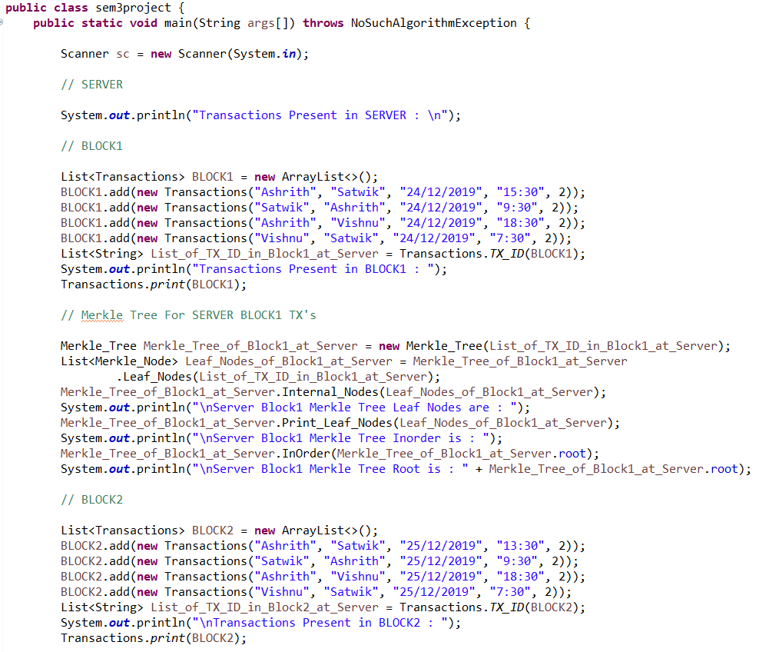
CODE AND IMPLEMENTATION

Slide 12
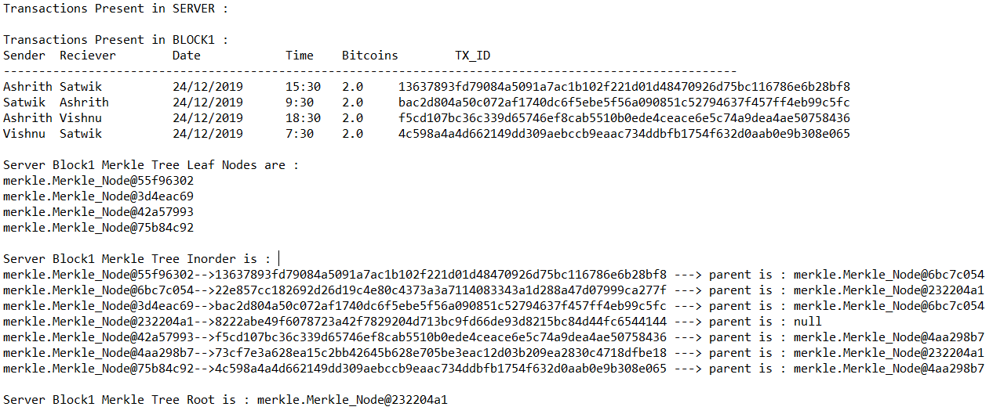
OUTPUT

Slide 13
Let's have a look into our code

